Slide 1


Reading Report 7
Language Models are Unsupervised Multitask Learners

Slide 2
Introduction
Traditional Approach:
NLP tasks like question answering and translation use supervised learning on large, annotated datasets
WebText & Zero-Shot Shift:
GPT-2, trained on millions of web pages (WebText), performs NLP tasks without explicit supervision
Key Result:
Achieves 55 F1 on CoQA without using 127k training examples, surpassing 3 of 4 baselines
Model Capacity Matters:
Larger models like GPT-2 (1.5B parameters) improve performance across tasks in a log-linear fashion

Slide 3
Towards Generalized ML From Narrow Experts to Zero-Shot
Current ML Systems:
Perform well on narrow tasks but struggle with generalization and data shifts
Challenges:
Erratic performance in tasks like captioning and image classification due to single-task training
Multitask Learning:
Benchmarks like GLUE show promise, but multitask training is still nascent
Zero-Shot Potential:
Pre-trained language models can perform tasks without fine-tuning, showing promise for generalized ML

Slide 4
Core Approach of Language Modeling
Language Modeling:
Framed as unsupervised distribution estimation over sequences of symbols
Conditional Probabilities:
Factorize joint probabilities into conditional probabilities for tractable sampling, e.g., p(x) = ∏ p(sn|s1,...,sn−1)
Self-Attention & Transformer:
Modern architectures like the Transformer improve conditional probability computation
Task Learning:
General models learn tasks as p(output|input, task), leveraging language to specify tasks, inputs, and outputs
Multitask Learning:
Language models can infer and perform multiple tasks without explicit supervision

Slide 5
Experimental Setup
Training:
Four Language Models (LMs) were trained, including GPT, BERT, and GPT-2, with varying sizes and learning rates optimized for best perplexity on WebText
Language Modeling:
GPT-2 excelled at zero-shot transfer across domains, improving perplexity and achieving state-of-the-art results on 7 of 8 datasets
CBT & LAMBADA:
Significant performance boosts were seen in Children’s Book Test (93.3% on nouns) and LAMBADA dataset (accuracy from 19% to 52.66%), highlighting GPT-2's ability to handle long-term dependencies
Challenges:
While GPT-2 outperformed in many areas, it struggled with datasets like the One Billion Word Benchmark due to heavy preprocessing

Slide 6
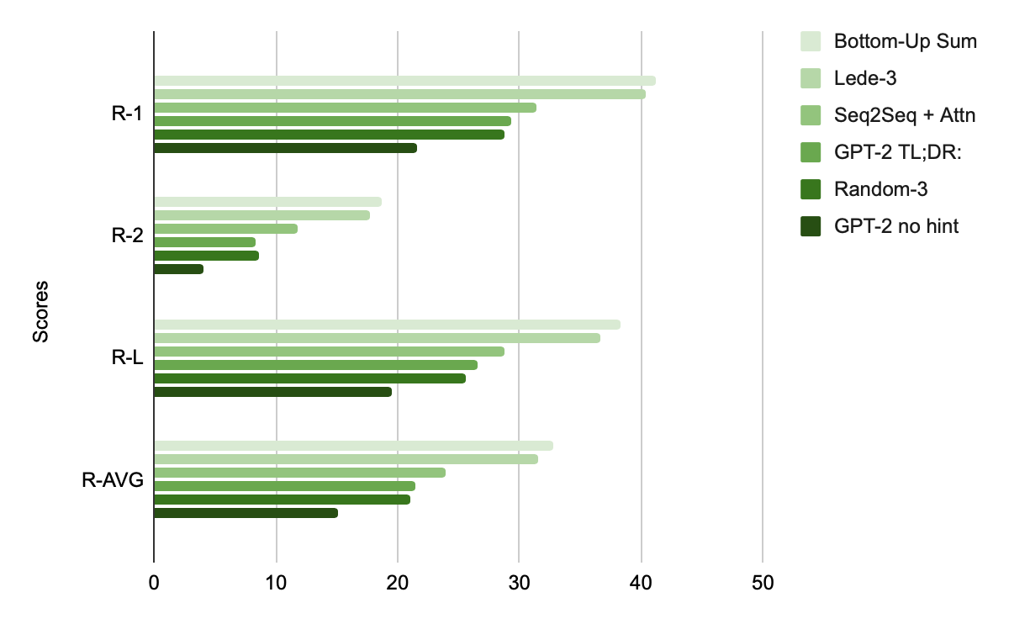
Performance Comparision

Slide 7
Generalization v/s Memorization
Aspect | Generalization | Memorization
Definition | Performs well on unseen data | Relies on recalling training data
Dataset Overlap | Low overlap (1-6%) | High overlap (e.g., 13.2% in 1BW)
Impact | Reflects true model capabilities | Inflates reported performance
Example | CoQA (0.5-1.0 F1 gain due to overlap) | GPT-2 shows some memorization, but still underfits WebText
Best Practice | De-duplicate training and test splits | Avoid excessive overlap in datasets

Slide 8
Discussion and Conclusion
Unsupervised Task Learning:
Shows potential for models to perform tasks without supervision
Zero-Shot Performance:
GPT-2 competes in reading comprehension but underperforms in summarization
Capacity Matters:
Performance improves with model capacity; many tasks still fail to exceed random guessing
Fine-Tuning Exploration:
Further investigation needed on benchmarks like decaNLP and GLUE
Overall Insight:
Large, diverse datasets enable models like GPT-2 to excel across various tasks with minimal supervision

Slide 9
Quiz Question
Question: How do larger language models, trained on vast amounts of data, typically perform in comparison to their smaller counterparts?
A) Smaller models consistently outperform larger ones in all scenarios.
B) The performance of larger models significantly enhances as both the model size and the dataset size increase.
C) Increasing the training data does not provide any benefits for larger models.
D) The performance of larger models is entirely determined by the underlying architecture, not by size or data.
Answer:
The Correct Answer is Option B

